Slide 1








Delicious Pizza for Everyone!
Pizza Sales Analysis

Slide 2

Hello!
My name is Harsh Tripathi … This project explores the world of pizza sales through the power of SQL. By analyzing sales data, I aim to identify key trends, customer preferences, and growth opportunities.

Slide 3


Questions for this project
Retrieve the total number of orders placed.
Calculate the total revenue generated from pizza sales.
Identify the highest-priced pizza.
Identify the most common pizza size ordered.
List the top 5 most ordered pizza types along with their quantities.
Join the necessary tables to find the total quantity of each pizza category ordered.
Determine the distribution of orders by hour of the day.
Join relevant tables to find the category-wise distribution of pizzas.
Group the orders by date and calculate the average number of pizzas ordered per day.
Determine the top 3 most ordered pizza types based on revenue.
Analyze the cumulative revenue generated over time.
Determine the top 3 most ordered pizza types based on revenue for each pizza category.

Slide 4
Let’s start To Solve The Questions….

Slide 5


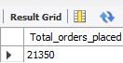
Retrieve the total number of orders placed.

Slide 6
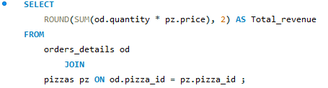
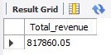
2)Calculate the total revenue generated from pizza sales.

Slide 7
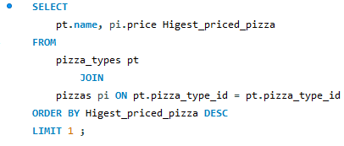
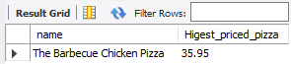
3) Identify the highest-priced pizza.

Slide 8
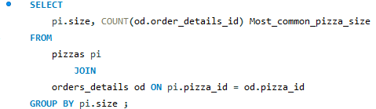
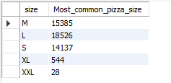
4) Identify the most common pizza size ordered.

Slide 9
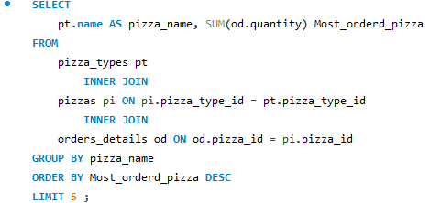
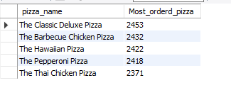
5) List the top 5 most ordered pizza types along with their quantities.

Slide 10
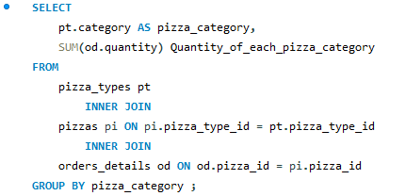
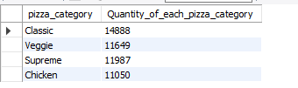
6)Join the necessary tables to find the total quantity of each category ordered.

Slide 11
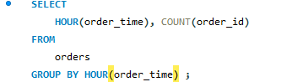

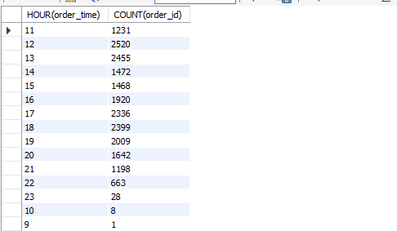
7) Determine the distribution of orders by hour of the day.

Slide 12
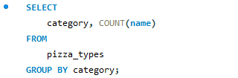

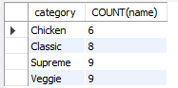
8)Join relevant tables to find the category-wise distribution of pizzas.

Slide 13
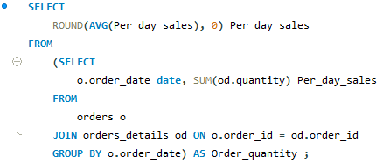

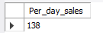
9)Group the orders by date and calculate the average number of pizzas ordered per day.

Slide 14
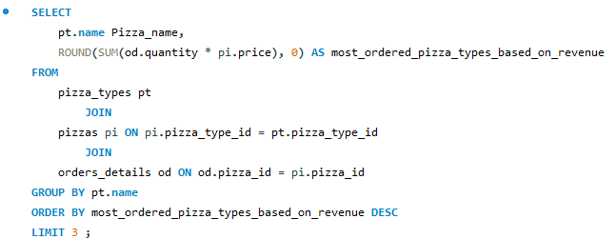

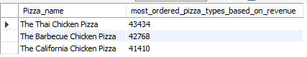
10) Determine the top 3 most ordered pizza types based on revenue.

Slide 15
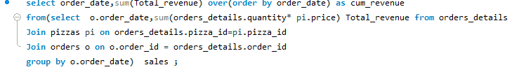
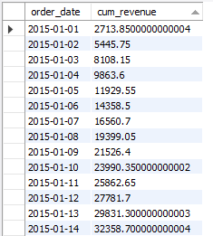

11)Analyze the cumulative revenue generated over time.

Slide 16
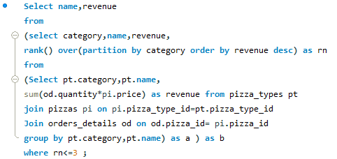

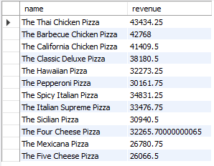

12) Determine the top 3 most ordered pizza types based on revenue for each pizza category.

Slide 17
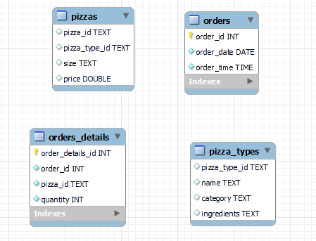
It’s our EER Diagram

Slide 18
This SQL Pizza Sales analysis can be a powerful tool in several ways:
1)Improved Decision Making
2) Cost Optimization
3)Understanding Customer Behavior
4) Predictive Analysis
(Overall, your SQL Pizza Sales project can be a valuable tool for any business owner or entrepreneur looking to gain insights into their pizza sales, optimize operations, and make data-driven decisions to achieve sustainable growth.)

Slide 19
THANK
YOU

